Slide 1

E-Portfolio Docusaurus
Dinosaurs are cool

Slide 2
Agenda:
About
Configuration
Example Implementation Demo Page

Slide 3
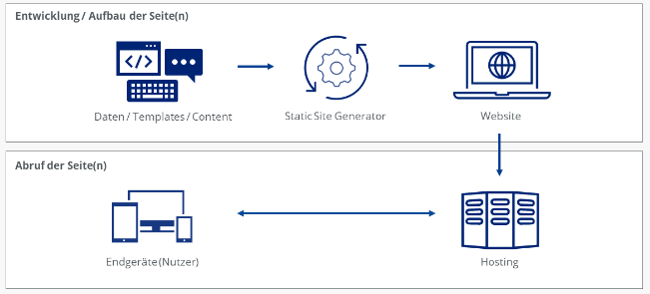
About Docusaurus
Open source project
Static Site Generator

Slide 4

About Docusaurus
Versionierung
I18n
Suche

Slide 5

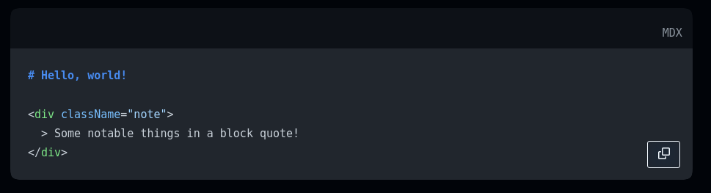
About Docusaurus
Themes
MDX
React

Slide 6
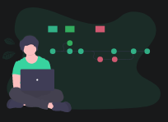
Configuration
Node Version
Installation

Slide 7

Example Implementation Demo Page

